Slide 1
Meetings 1-9
Caring For Our Own
sponsored by the
New York State Office of Children and Family Services

Slide 2
Meeting 1
Introduction to Caring for Our Own

Slide 3
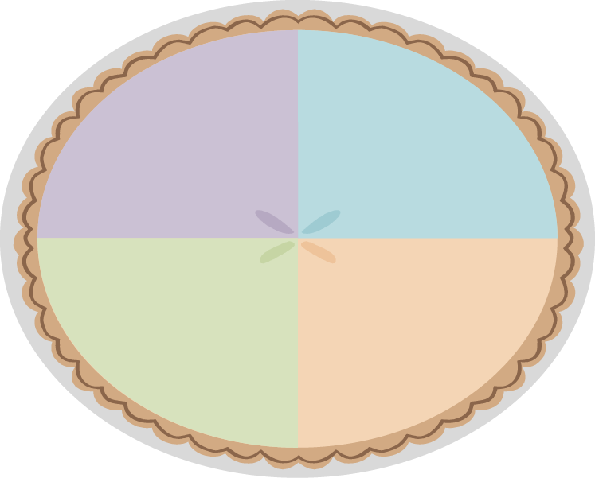
Friendship Pie
Favorite Color
Favorite Activity
Favorite Age/
Time of Life
Relationship to the Child

Slide 4
Definition of Kin
Any relative by blood, marriage or adoption, or any person with close family ties.
Meeting 1 Activity B-1

Slide 5
Relative Caregiver
An individual providing out-of-home care for a child with whom he or she is related.
The full-time nurturing and protection of children who must be separated from their parents by relatives, members of their tribes or clans, godparents or other adults who have a kinship bond with a child.
Out-of-home foster care provided by a relative.

Slide 6
Reasons for Relative/Kinship Placement
Enables children to live with people they know and trust.
Reduces the trauma of living with persons who initially are unknown.
Supports the transmission of a child’s family identity, culture and ethnicity.
Facilitates children’s connections to their siblings.
Strengthens the ability of families to give children the support they need.

Slide 7
Common Themes Among Relative/Kinship Caregivers
The relationship of kinship caregivers with the helping network.
The relationship of kinship caregivers with the children in their care.
The relationship of kinship caregivers with the birth parents of the children in their care.

Slide 8
Handout 2

Slide 9
Child Welfare Initiatives
Safety
Permanency
Adult Self-Sufficiency
Child Well-Being

Slide 10
Strengths
Skills, resources, qualities and experiences that are part of each person.
Needs
Underlying conditions that must be met before a person can achieve a goal.

Slide 11
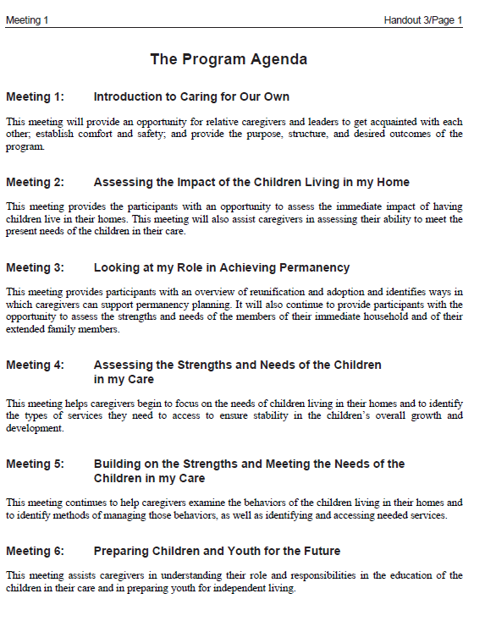
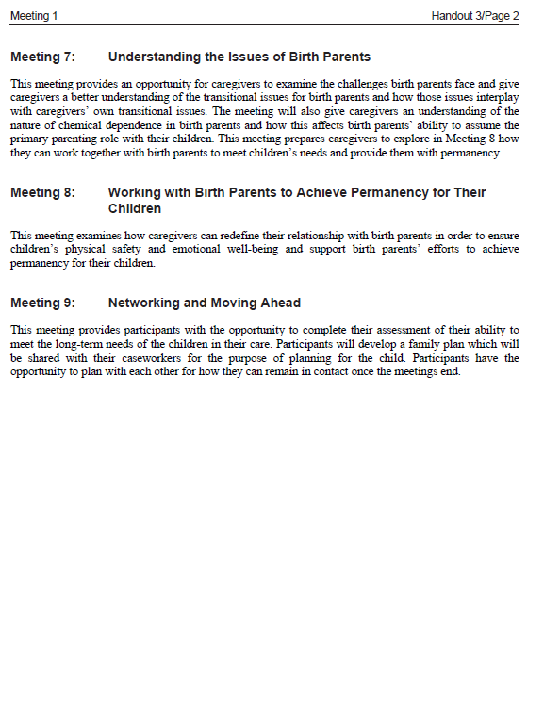
Handout 3

Slide 12
The Group’s Goals and Expectations

Slide 13
Ground Rules

Slide 14
Benefits of a Support Group

Slide 15
Handout 4

Slide 16
Meeting 2
Assessing the Impact of Children Living in My Home
© 2014 New York State Office of Children and Family Services.

Slide 17
Review to Renew
R ________________________________________
E ________________________________________
L ________________________________________
A ________________________________________
T ________________________________________
I ________________________________________
V ________________________________________
E ________________________________________

Slide 18
Handout 4 (From Mtg 1)

Slide 19
Family Assessment
An evaluation (self-assessment) of the strengths and needs of an individual and/or his family members, which will assist in planning for short- and long-term goals.

Slide 20
Personal Journal

Slide 21
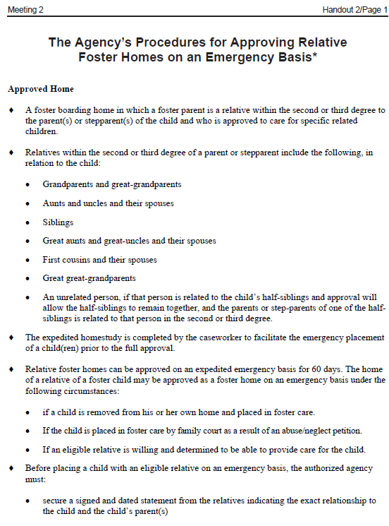
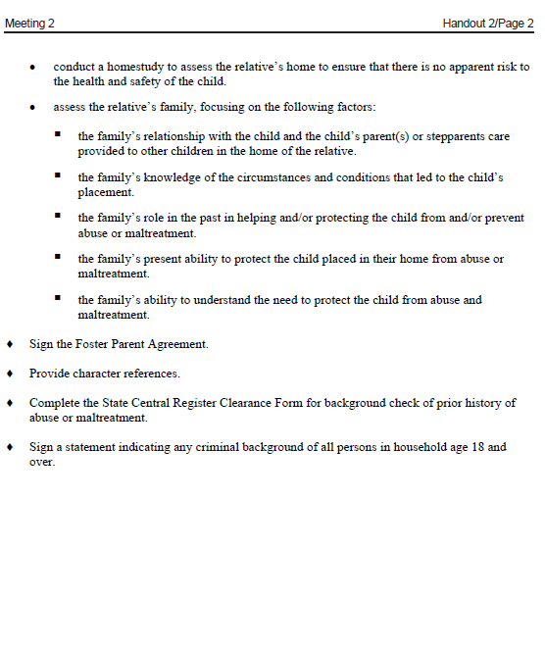
Handout 2

Slide 22
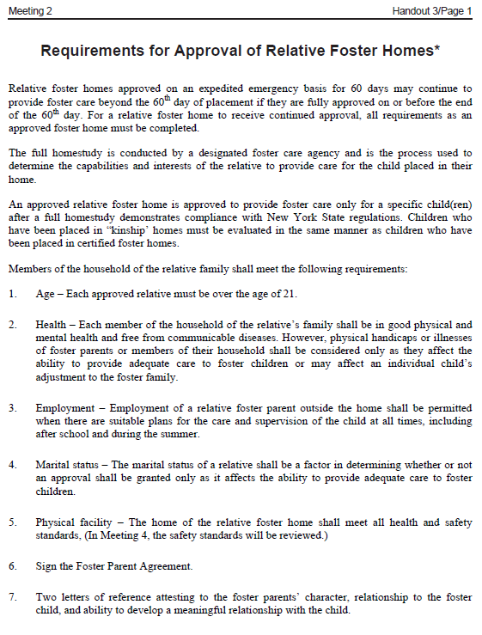
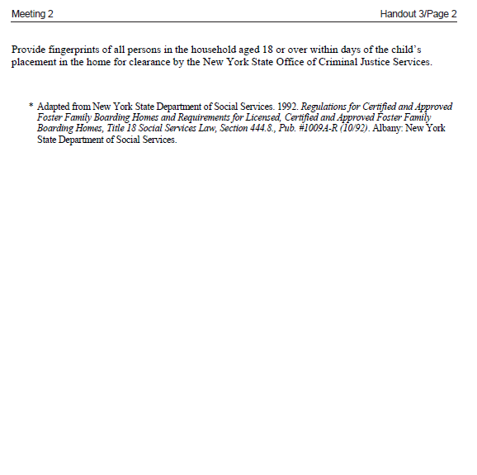
Handout 3

Slide 23
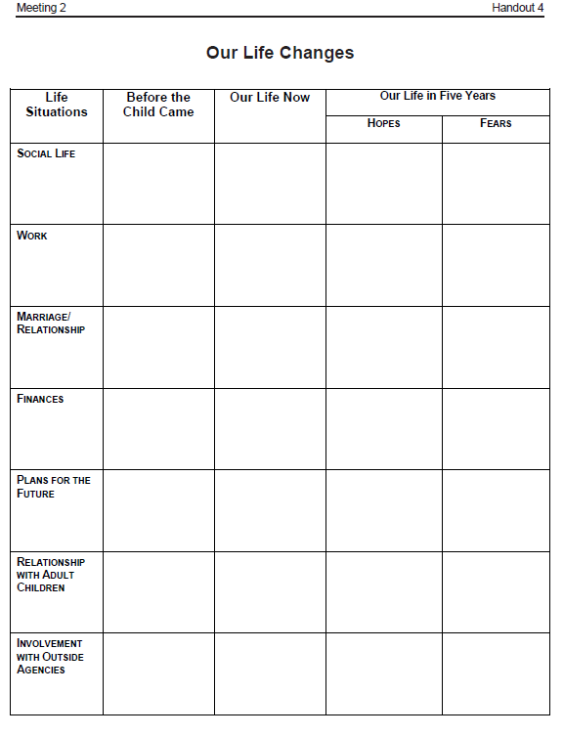
Handout 4

Slide 24
Our Life Changes
Life Situations Before Our Life Life in 5 Yrs Life in 5 Yrs the Child Now Hopes Fears
Social Life
Work
Marriage/ Relationship
Finances
Plans for the Future
Relations with Your Other Children
Involvement with Outside Agencies
© 2014 New York State Office of Children and Famil Services.

Slide 25
Meeting 3
Looking at My Role in Achieving Permanency
© 2014 New York State Office of Children and Family Services.

Slide 26
Review to Renew
P ________________________________________
E ________________________________________
R ________________________________________
M ________________________________________
A ________________________________________
N ________________________________________
E ________________________________________
N ________________________________________
C ________________________________________
Y ________________________________________

Slide 27
Reunification
A process by which a child is safely reunited with (returned to) his or her birth parent(s) or other caretaker.

Slide 28
Adoption
The legal process by which a child is freed from his or her birth parents, either by relinquishment or termination of parental rights, and placed with applicants who have been approved to take the child into their own family and raise the child as their own with all the rights and responsibilities granted thereto, including, but not limited to, the rights of inheritance.
Adoption is a lifelong commitment to a child. It is considered the most permanent plan for a child who is unable to return to his or her birth parents.

Slide 29
Permanency
The process whereby a child in out-of-home care is reunified with his or her birth parents, is adopted, or is eventually emancipated from foster care.

Slide 30
The Adoption and Safe Families Act (ASFA)
Established in 1997 to expedite the permanency process
A permanency goal is identified for each child
The permanency goal is established by the caseworker and approved by the court
The first permanency hearing must occur within 8 months of a child’s placement
The caseworker will make “reasonable efforts” to prevent the placement of children in out-of-home care and support the safe reunification of families
Agencies are required to make “reasonable efforts” to place the child in a timely manner to complete whatever steps are needed to finalize permanent placement

Slide 31
Concurrent Planning
The process whereby that at the same time a caseworker is making “reasonable efforts” to reunify a family, an alternative or contingency plan is also being developed for the child’s permanency.

Slide 32
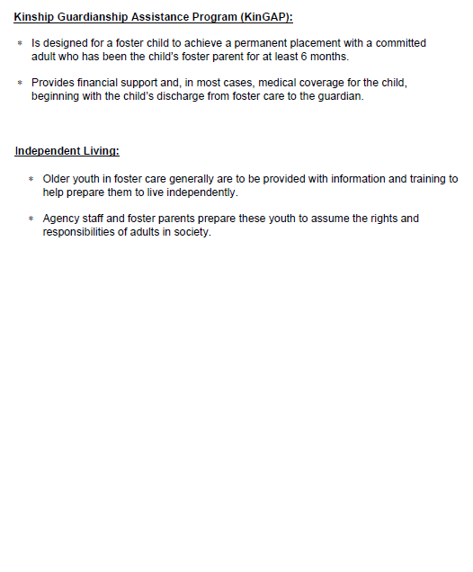
Handout 2

Slide 33
Supplemental Handout 1 KinGap Information
Handout Summary
KinGAP provides financial support and, in most cases medical coverage for the child.
The level of financial support is similar to the foster care board payments the foster parent received while the child was in care.
The prospective guardian must have been the foster parent to the child for at least 6 months.
The prospective guardian must have a strong commitment to caring for the child on a permanent basis and the child must have a strong attachment to the prospective guardian.
The birth parent’s rights do not have to be terminated.
“Return home” and “adoption” must be ruled out as permanency options for the child.
The fact finding hearing and the first permanency hearing must be completed before the prospective guardian applies to the local department of social services.

Slide 34
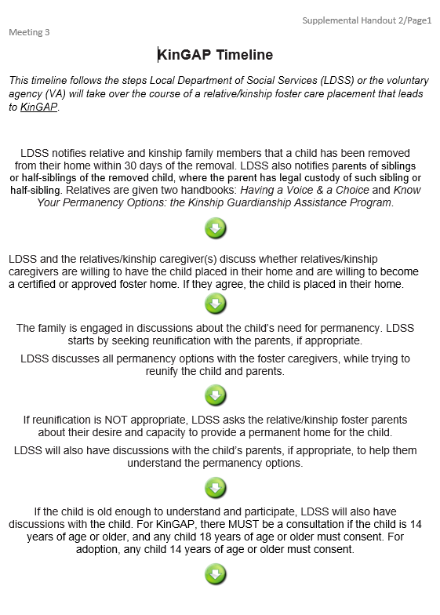
Supplemental Handout 2

Slide 35
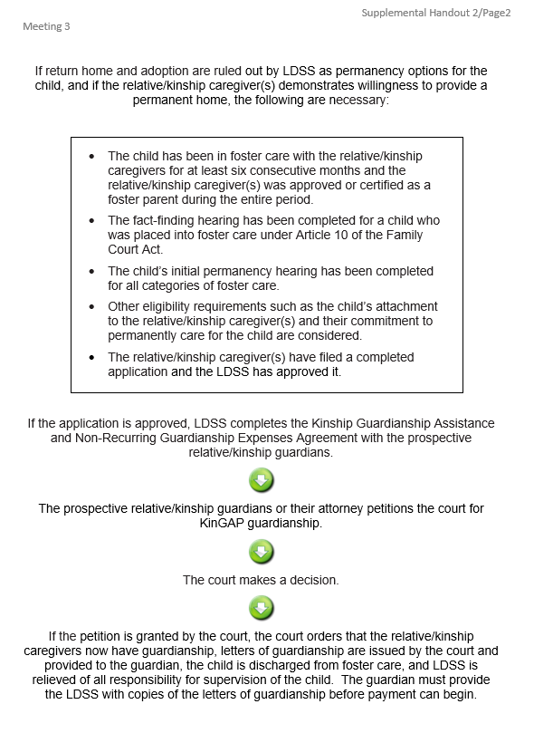
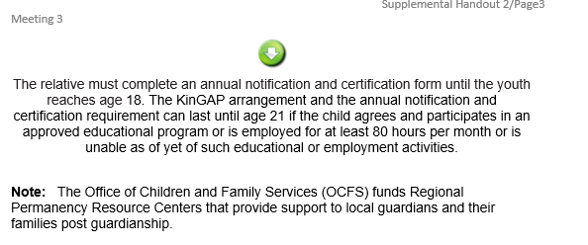
Supplemental Handout 2
(continued)

Slide 36
Handout 3

Slide 37
Foster Parent Agreement (placeholder)

Slide 38
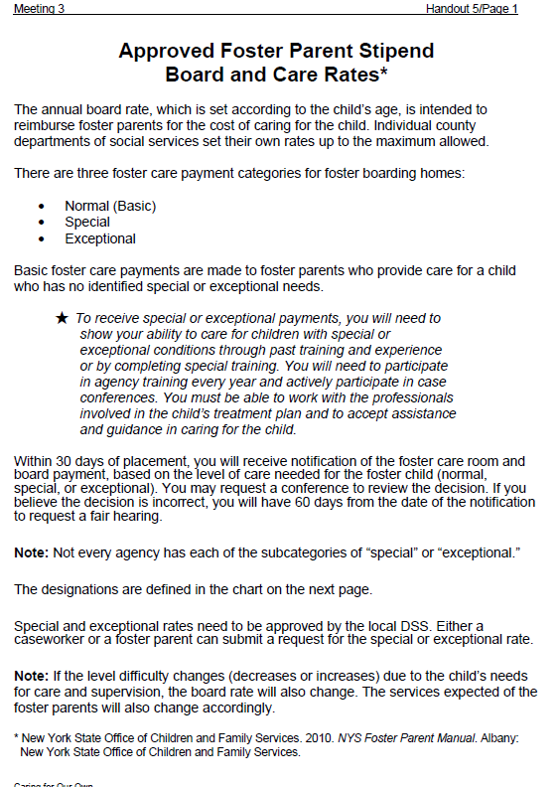
Handout 3

Slide 39
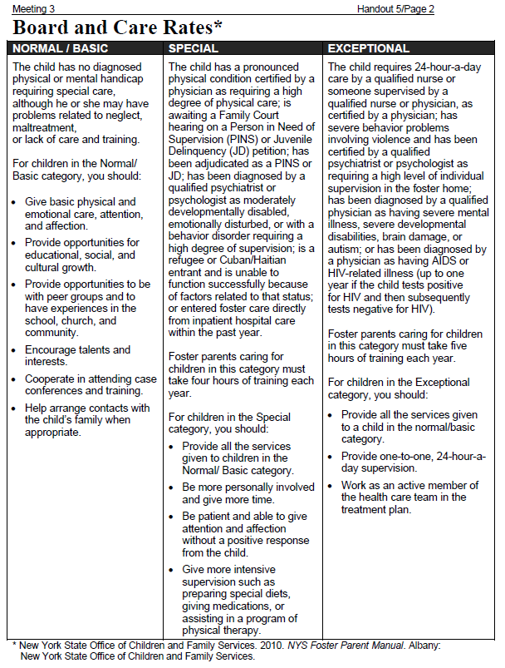
Handout 5

Slide 40
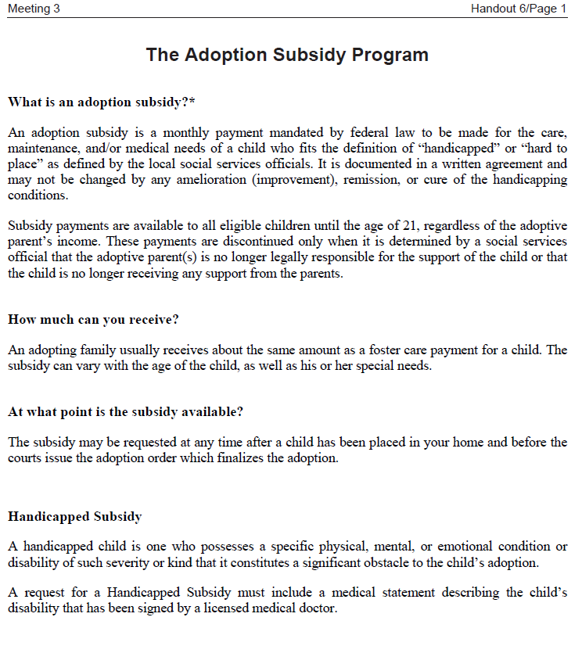
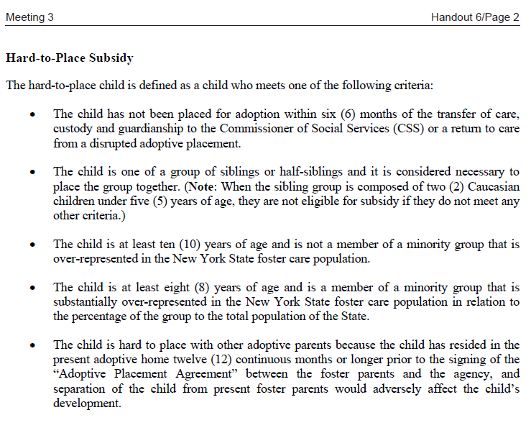
Handout 6

Slide 41
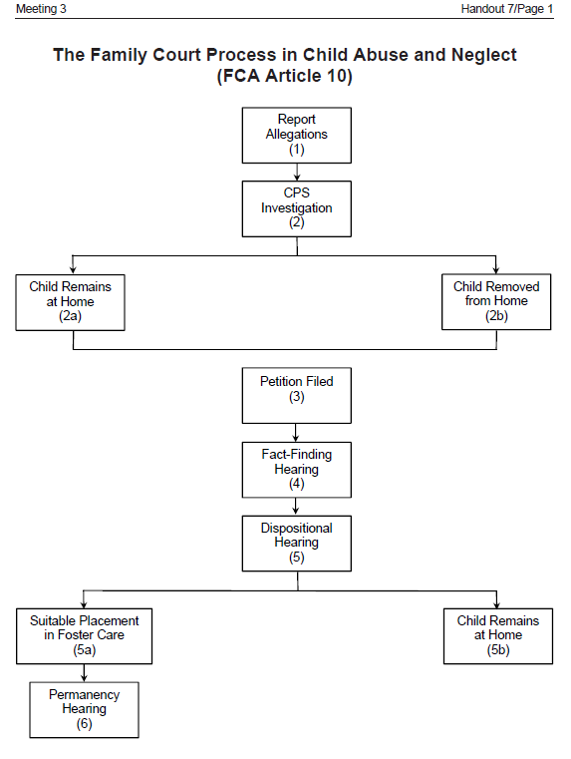
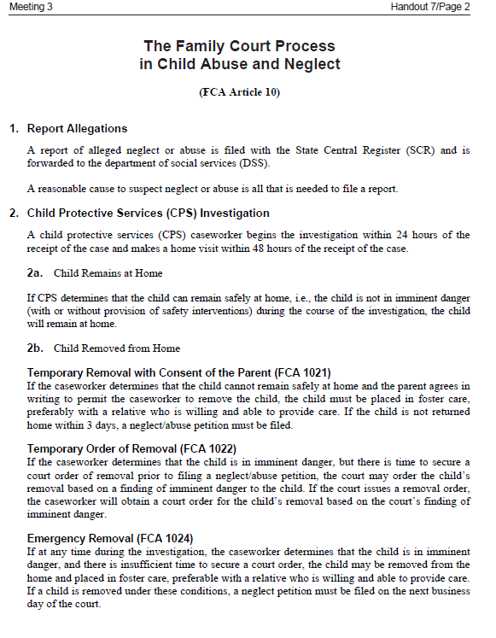
Handout 7

Slide 42
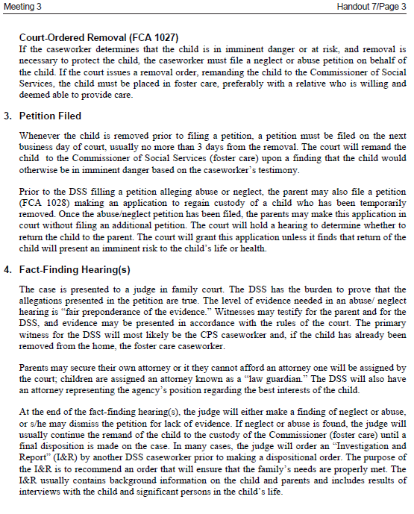
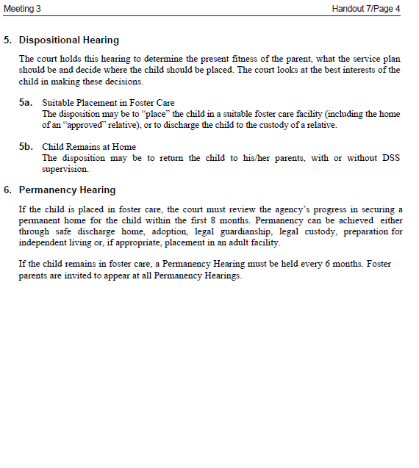
Handout 7 (continued)

Slide 43
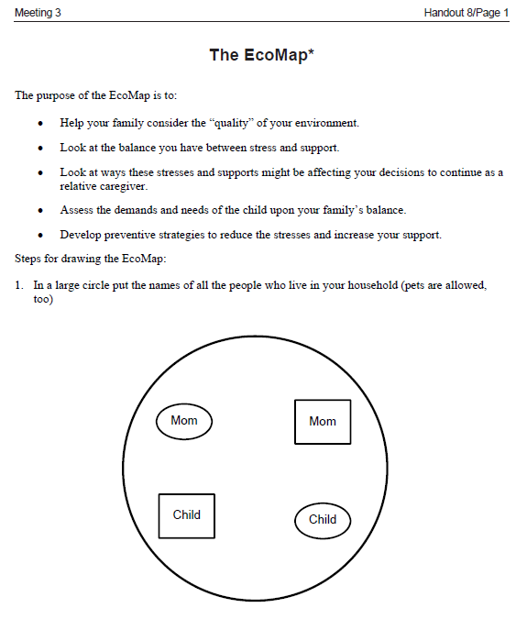
Handout 8, p.1

Slide 44
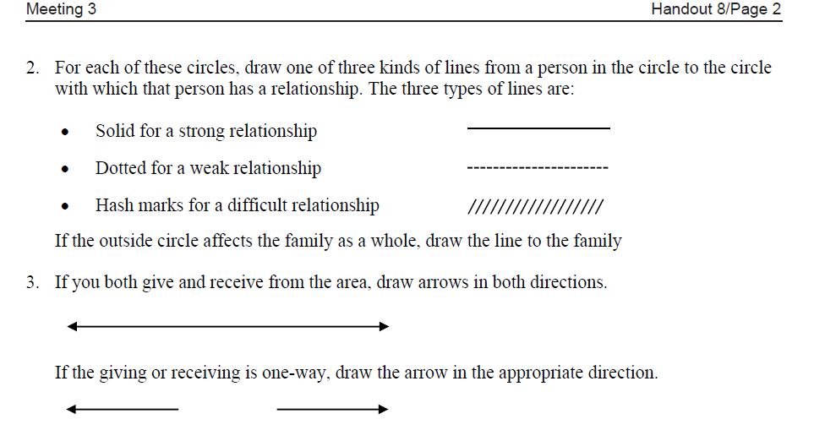
Handout 8, p.2

Slide 45
Leader’s Eco Map (placeholder)

Slide 46
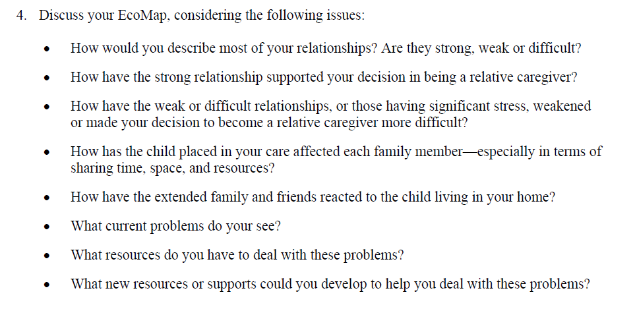
Handout 8, p.2

Slide 47
Transitional Issues
The natural reactions that Kinship Caregivers, Children and Birth Parents experience as a result of changes in their living arrangements, lifestyles and family roles.

Slide 48
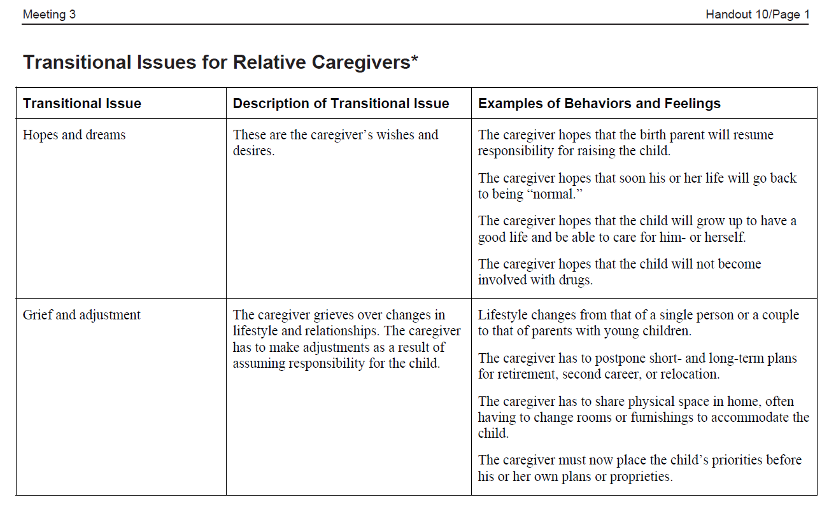
Handout 10, p.1

Slide 49
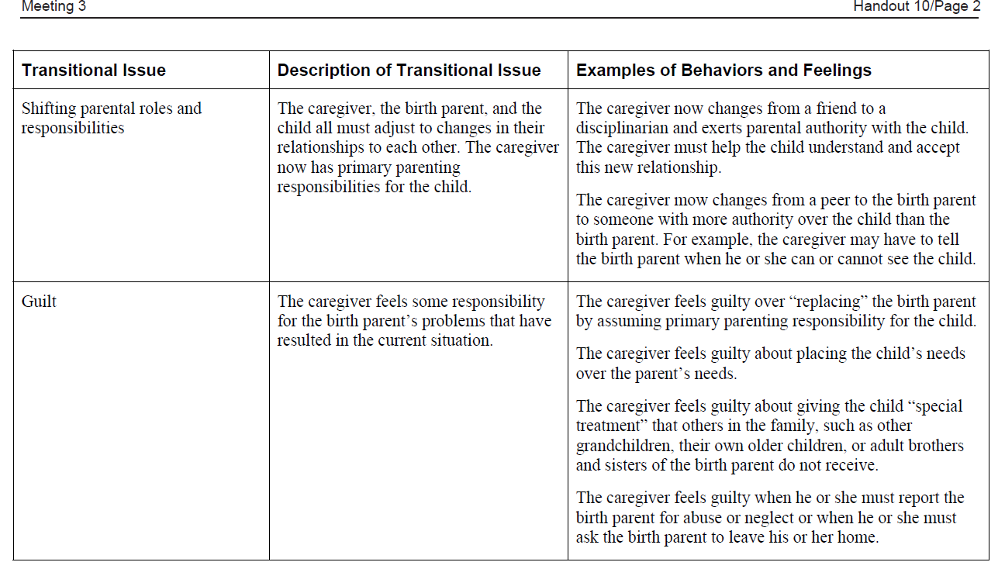
Handout 10, p.2

Slide 50
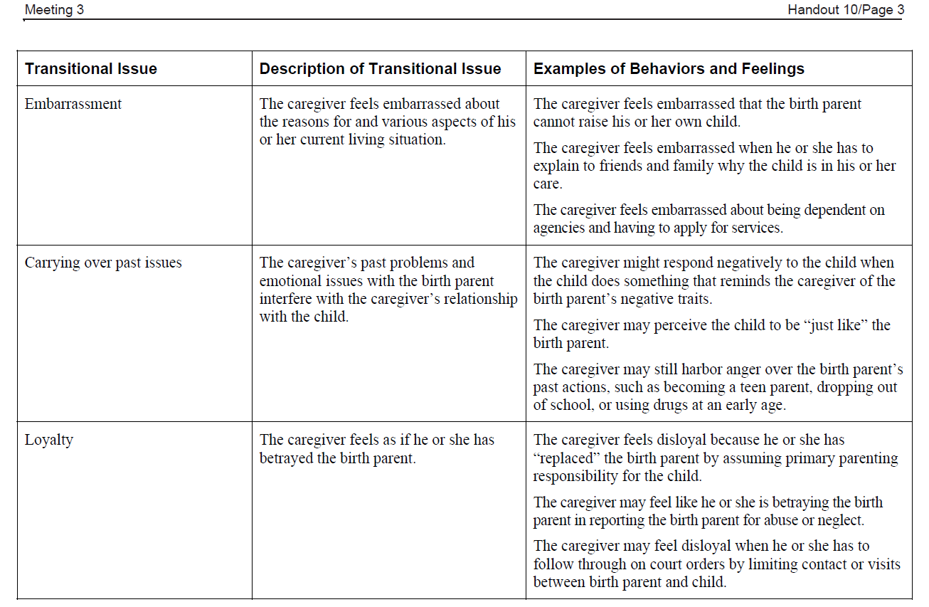
Handout 10, p.3

Slide 51
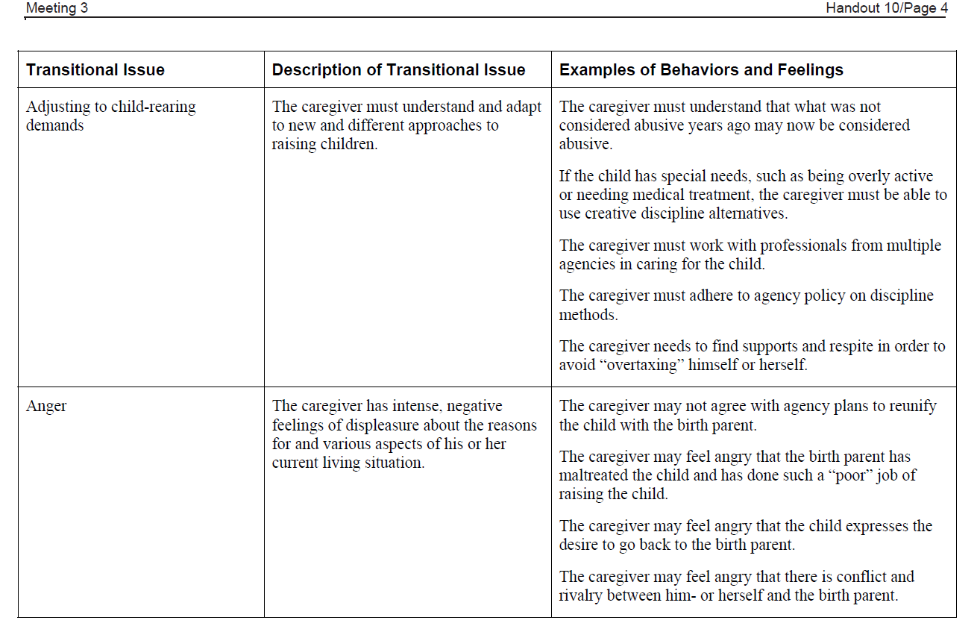
Handout 10, p.4

Slide 52
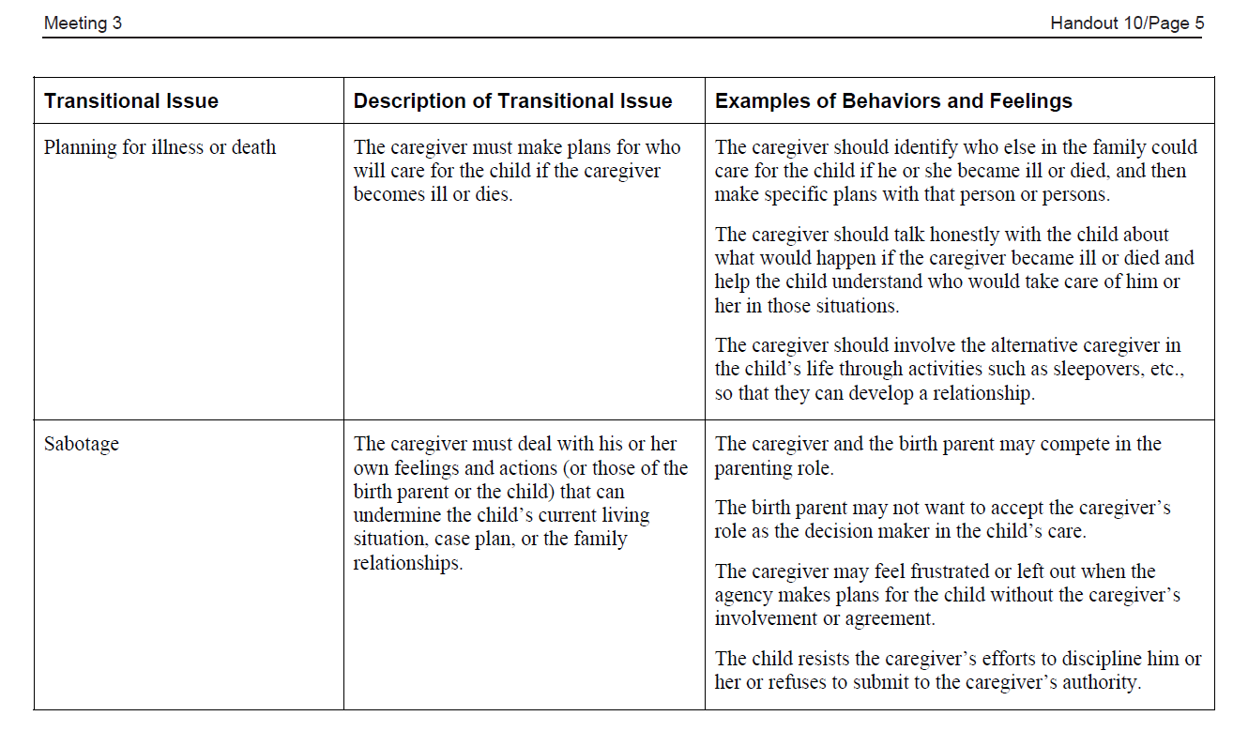
Handout 10, p.5

Slide 53
Meeting 4
Assessing the Strengths and Needs of the Children in My Care
© 2014 New York State Office of Children and Family Services.

Slide 54
Review to Renew
C ________________________________________
H ________________________________________
I ________________________________________
L ________________________________________
D ________________________________________

Slide 55
Reasons | Feelings | Behaviors

Slide 56
How would you define protection and safety?

Slide 57
Order of Placement Preference
Relative/Kinship Foster Home
Family Foster Home
Therapeutic Foster Home
Group Home
Group Residence
Group Residential Treatment Facility

Slide 58
Handout 2

Slide 59
Strengths
Skills, resources, qualities and experiences that are part of each person.
Needs
Underlying conditions that must be met before a person can achieve a goal.

Slide 60
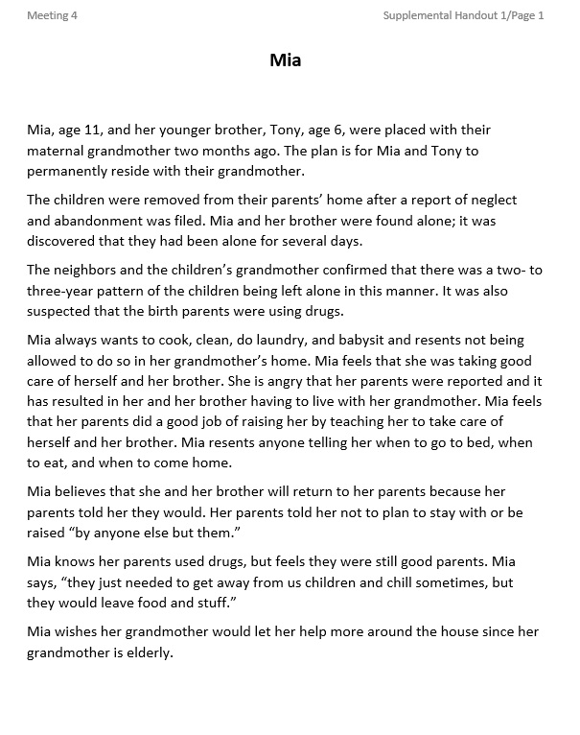
Supplemental Handout 1

Slide 61
Mia’s Weaknesses/Problems | Mia’s Needs | Mia’s Strengths

Slide 62
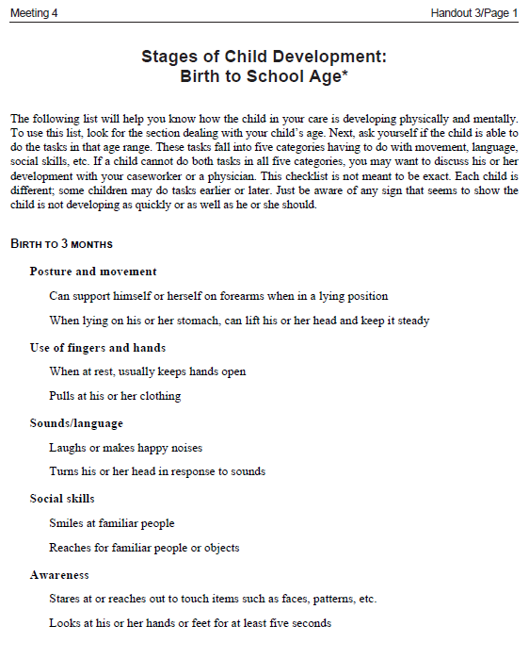
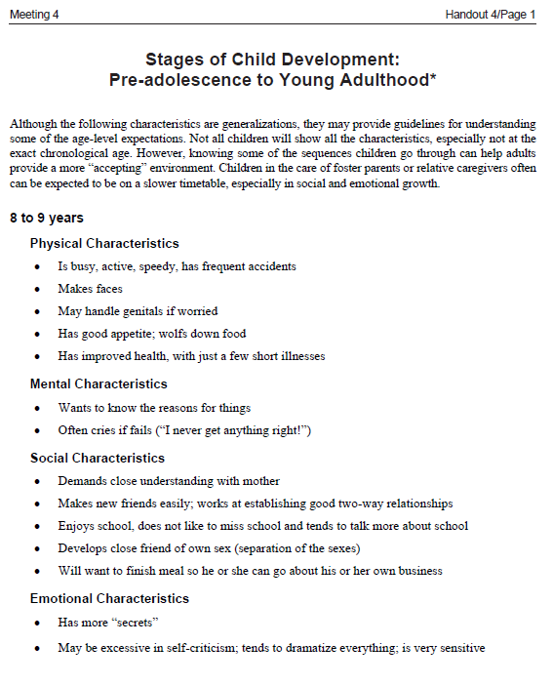
Handout 3 (9 pages)
Handout 4 (5 pages)

Slide 63
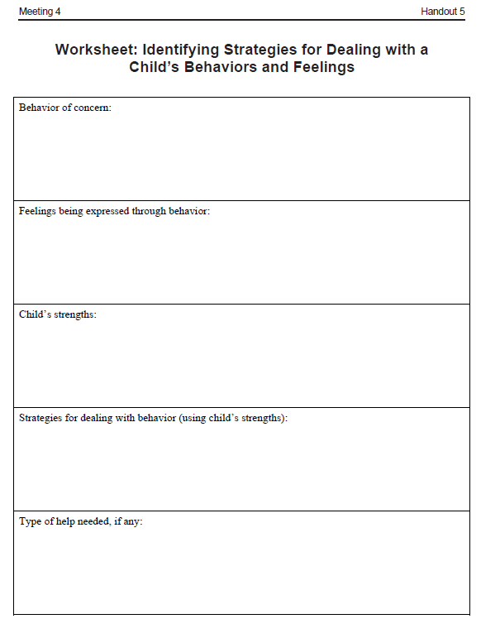
Handout 5

Slide 68
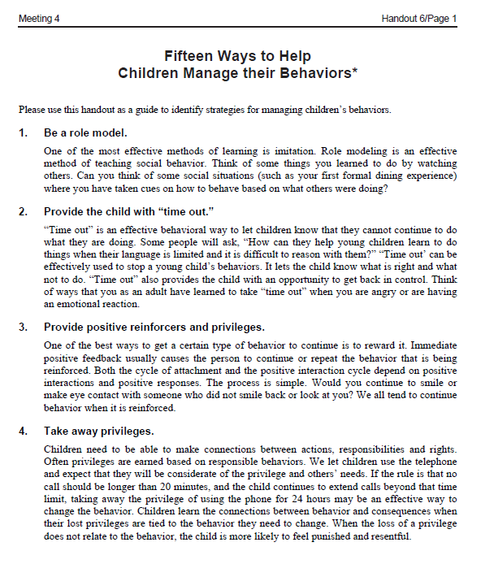
Handout 6. p.1

Slide 69
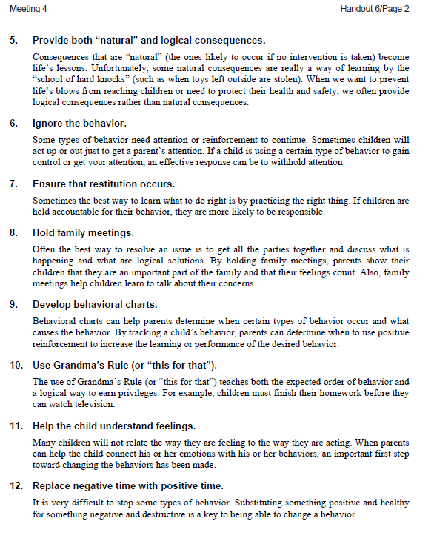
Handout 6. p.2

Slide 70
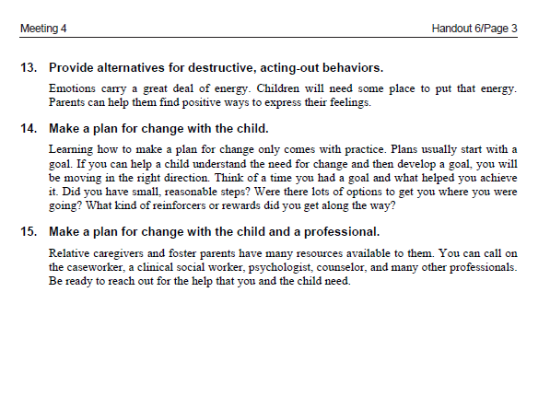
Handout 6, p.3

Slide 71
Meeting 5
Building on the Strengths and Meeting the Needs of the Children in My Care
© 2014 New York State Office of Children and Family Services.

Slide 72
Review to Renew
N ________________________________________
E ________________________________________
E ________________________________________
D ________________________________________
S ________________________________________

Slide 73
Transitional Issues
The natural reactions that Kinship Caregivers, Children and Birth Parents experience as a result of changes in their living arrangements, lifestyles and family roles.

Slide 74
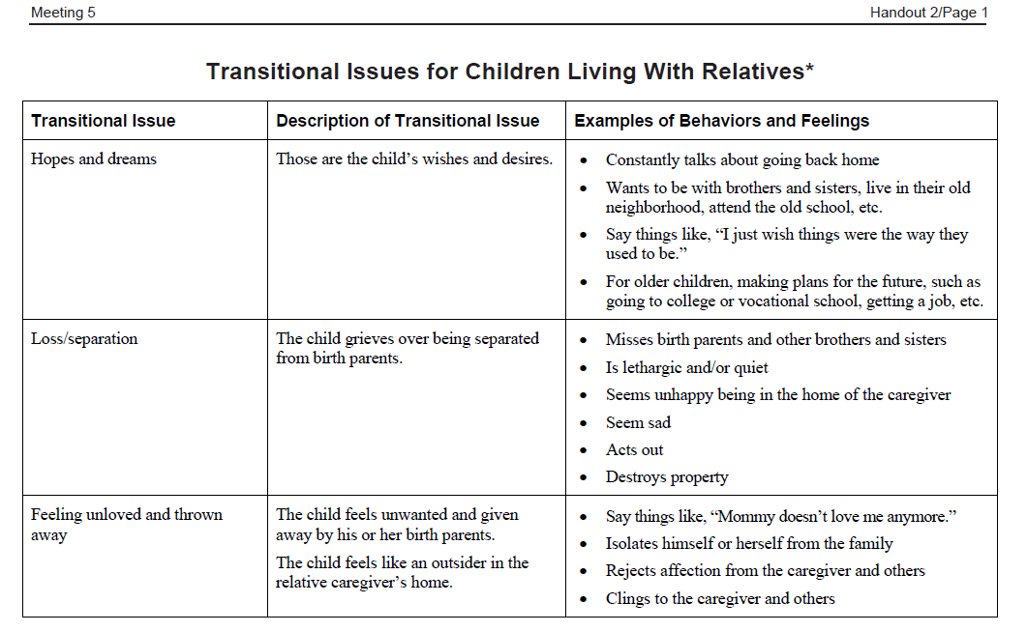
Handout 2, p.1

Slide 75
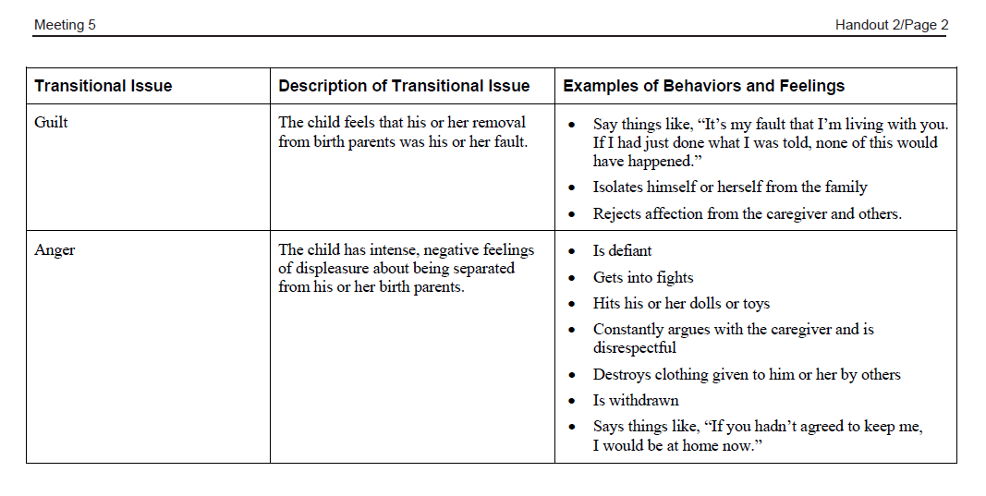
Handout 2, p.2

Slide 76
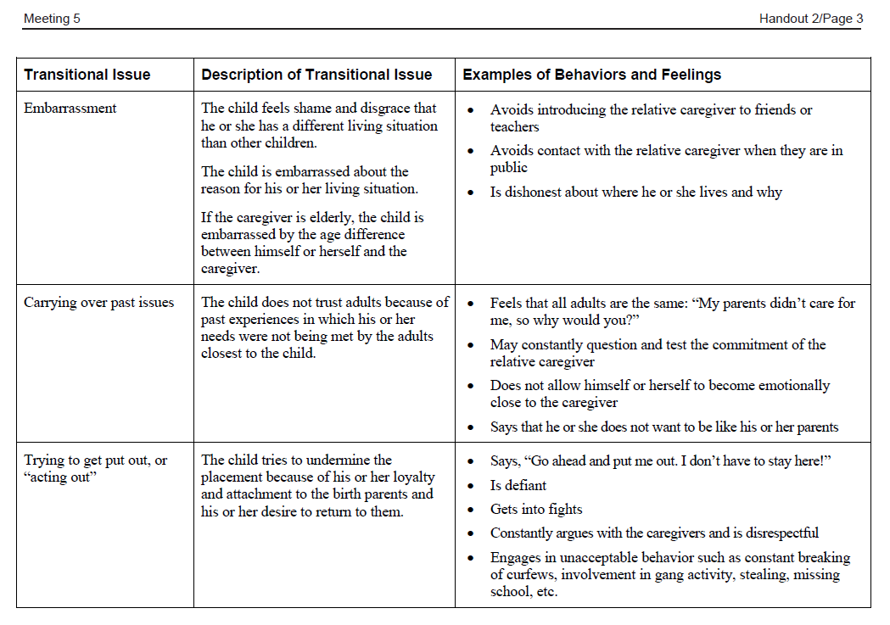
Handout 2, p.3

Slide 77
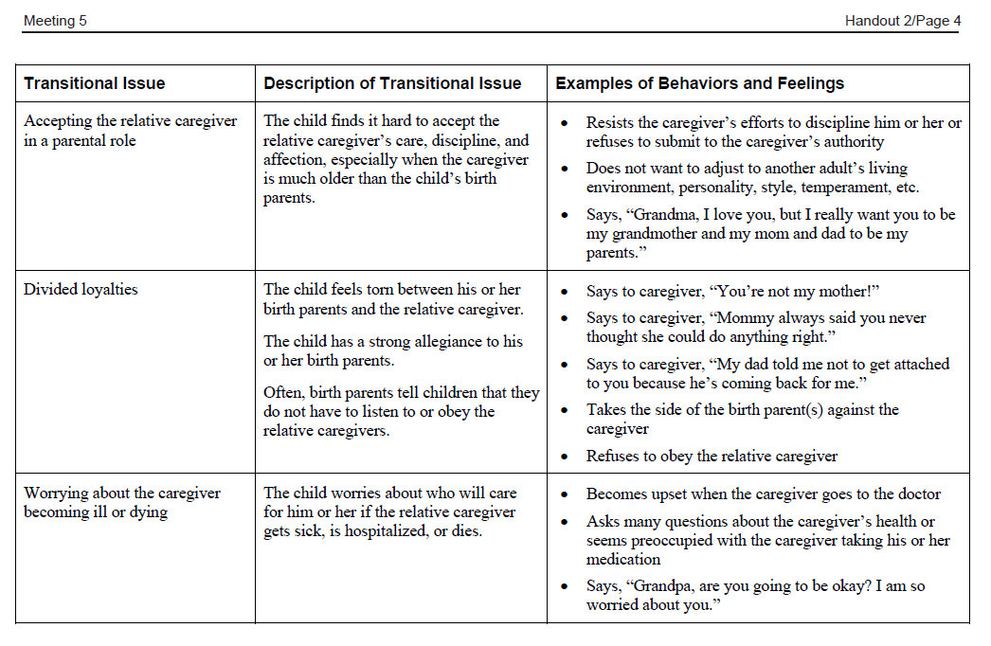
Handout 2, p.4

Slide 78
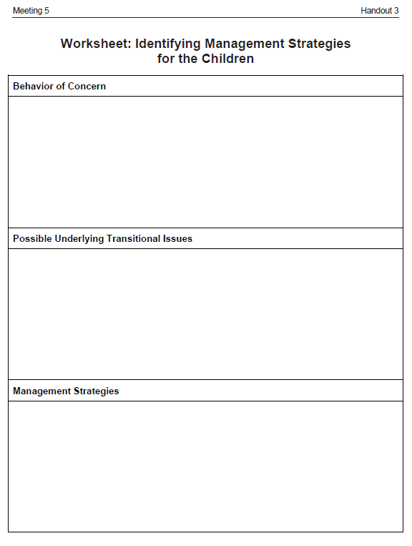
Handout 2, p.2
Handout 3

Slide 82
Meeting 6
Preparing Children and Youth for the Future
© 2014 New York State Office of Children and Family Services.

Slide 83
Review to Renew
A ________________________________________
D ________________________________________
V ________________________________________
O ________________________________________
C ________________________________________
A ________________________________________
T ________________________________________
E ________________________________________

Slide 84
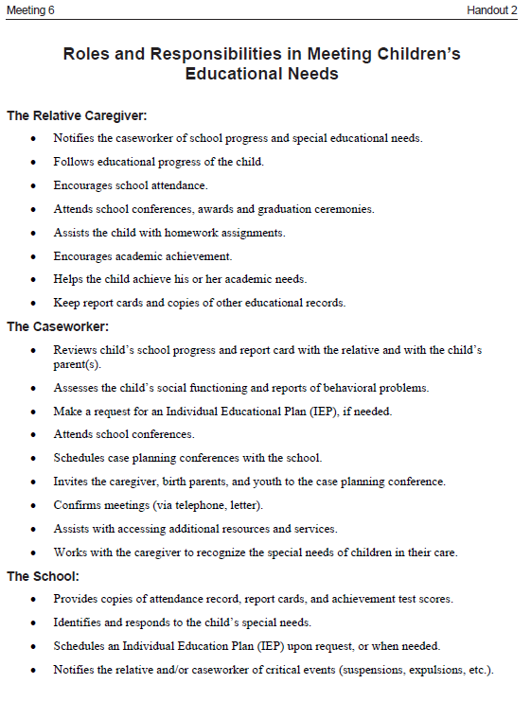
Handout 2

Slide 85
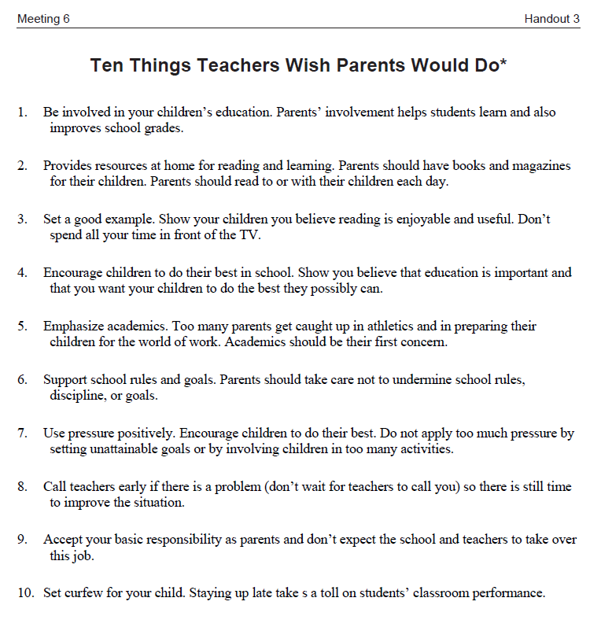
Handout 3

Slide 86
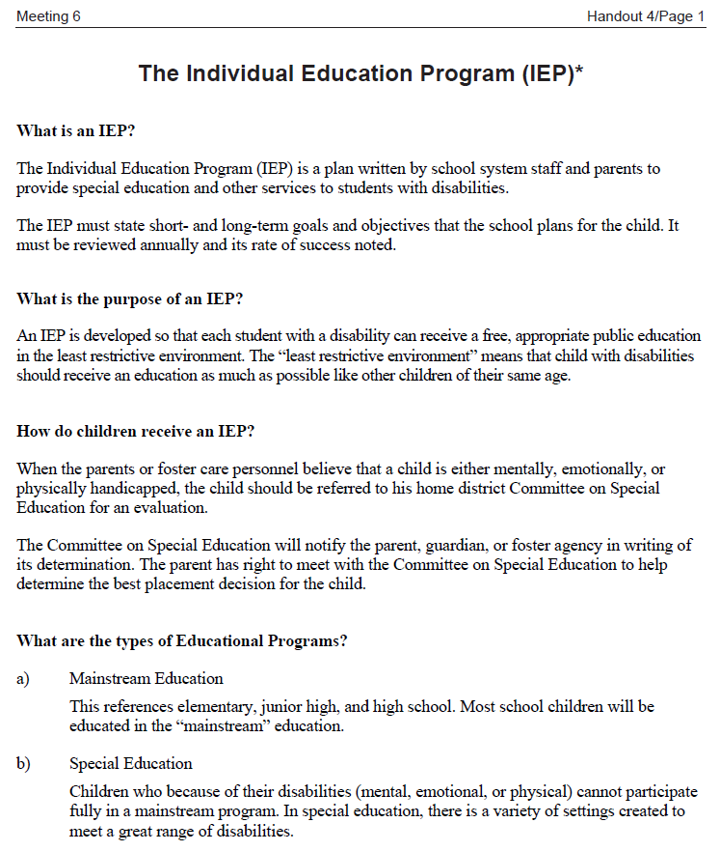
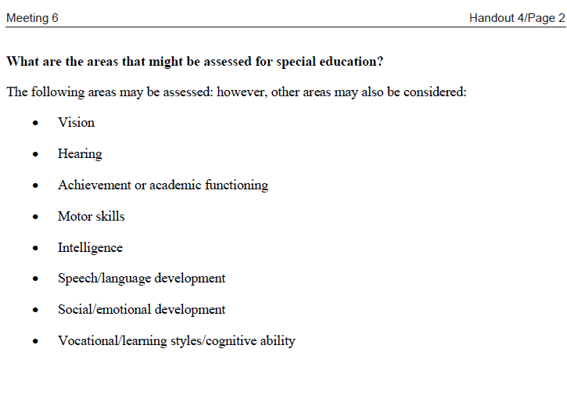
Handout 4

Slide 87
Emancipation
Emancipation is the process whereby a child becomes an adult at the age of 21 (or earlier if the youth demonstrates that he or she has all essential independent living skills).
At the age of 21, the youth is terminated from DSS and family court jurisdiction, and is no longer in need of child protective services. The youth becomes responsible for securing his or her basic necessities of life, such as shelter, food, clothing, etc.”
Emancipation Planning
An ongoing process whereby specific services are identified which will enable a youth in out-of-home placement to emancipate from the child welfare system.

Slide 88
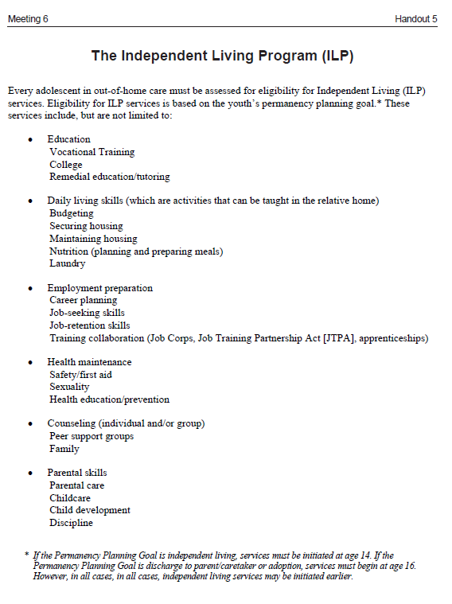
Handout 5

Slide 89
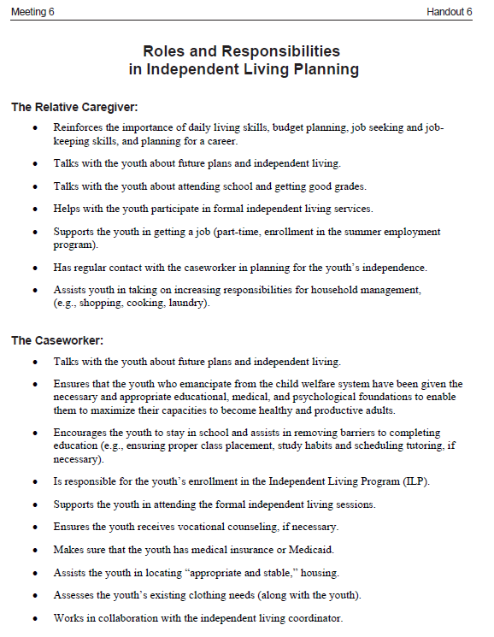
Handout 6

Slide 90
Let’s Review: The Eco Map
Handout 8
(from Meeting 3)

Slide 91
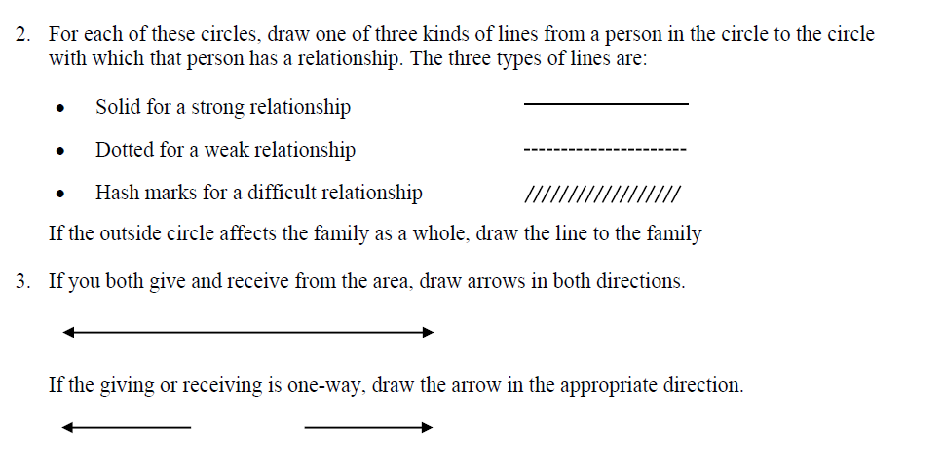
Let’s Review: The Eco Map

Slide 92
Sample Birth Parent’s Eco Map (placeholder)

Slide 93
Individual Activity
1. Imagine yourself as the birth parents.
Identify persons in the immediate family of the birth parents (self, partner/spouse, children).
Identify persons in the extended family
Identify outside systems with which the birth parents are involved.
Draw the Eco Map of the birth parents
Identify the kinds of relationships (using the Eco Map symbols).

Slide 94
Questions for Large Group Discussion
1. How would you describe the birth parents’ relationships? Are they strong? weak? difficult?
2. Which relationships are strong?
Which relationships are stressful?
4. With whom are the birth parents experiencing conflict?
5. What symbols did you use to depict the relationship between the birth parents and yourself? How do you think the birth parents perceive their relationship with you?

Slide 95
Meeting 7
Understanding the Issues of Birth Parents
© 2014 New York State Office of Children and Family Services.

Slide 96
Review to Renew
P ________________________________________
A ________________________________________
R ________________________________________
E ________________________________________
N ________________________________________
T ________________________________________

Slide 97
Transitional Issues
The natural reactions that Kinship Caregivers, Children and Birth Parents experience as a result of changes in their living arrangements, lifestyles and family roles.

Slide 98
Transitional Issues for Relative Caregivers | Transitional Issues for Children | Transitional Issues for Parents
Hopes and Dreams | Hopes and Dreams | Hopes and Dreams
Grief and Adjustment | Loss/Separation | Grief and Remorse
Shifting Parental Roles and Responsibilities | Feeling Unloved and Thrown Away | Accepting a New Relationship
Guilt | Guilt | Guilt
Embarrassment | Embarrassment | Feeling Under the Relative’s & Agency’s Authority
Carrying Over Past Issues | Carrying Over Past Issues | Carrying Over Past Issues
Loyalty | Divided Loyalties | Feeling Betrayed
Adjusting to Childrearing Demands | Accepting Caregiver in Parental Role | Anger & Disappointment
Anger | Anger | Planning for Illness or Death
Planning for Illness or Death | Worry About Caregiver Becoming Ill or Dying
Sabotage

Slide 99
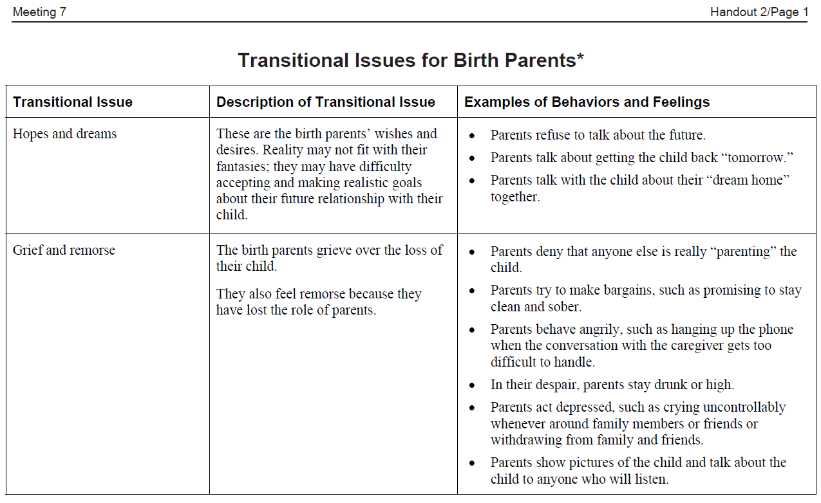
Handout 2, p.1

Slide 100
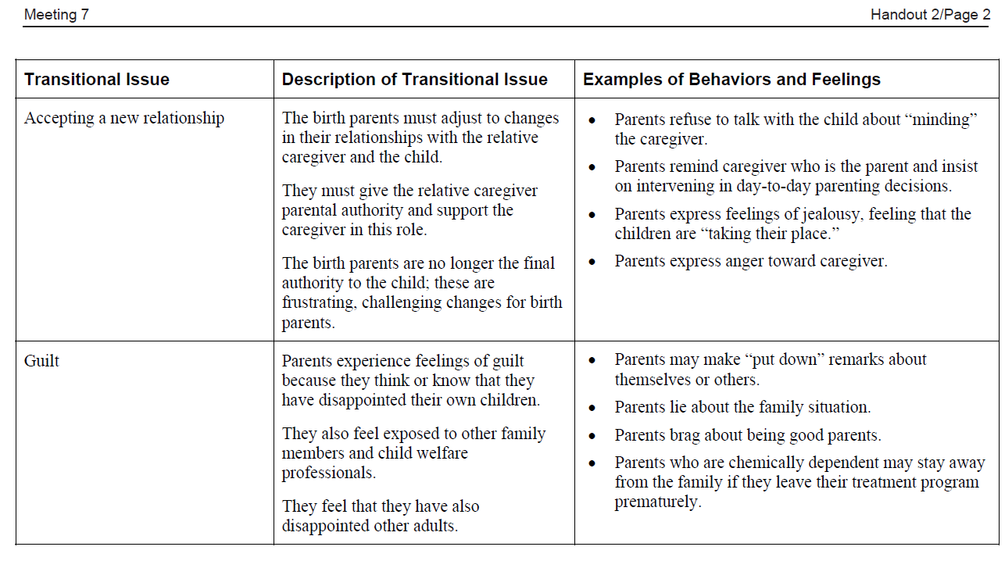
Handout 2, p.2

Slide 101
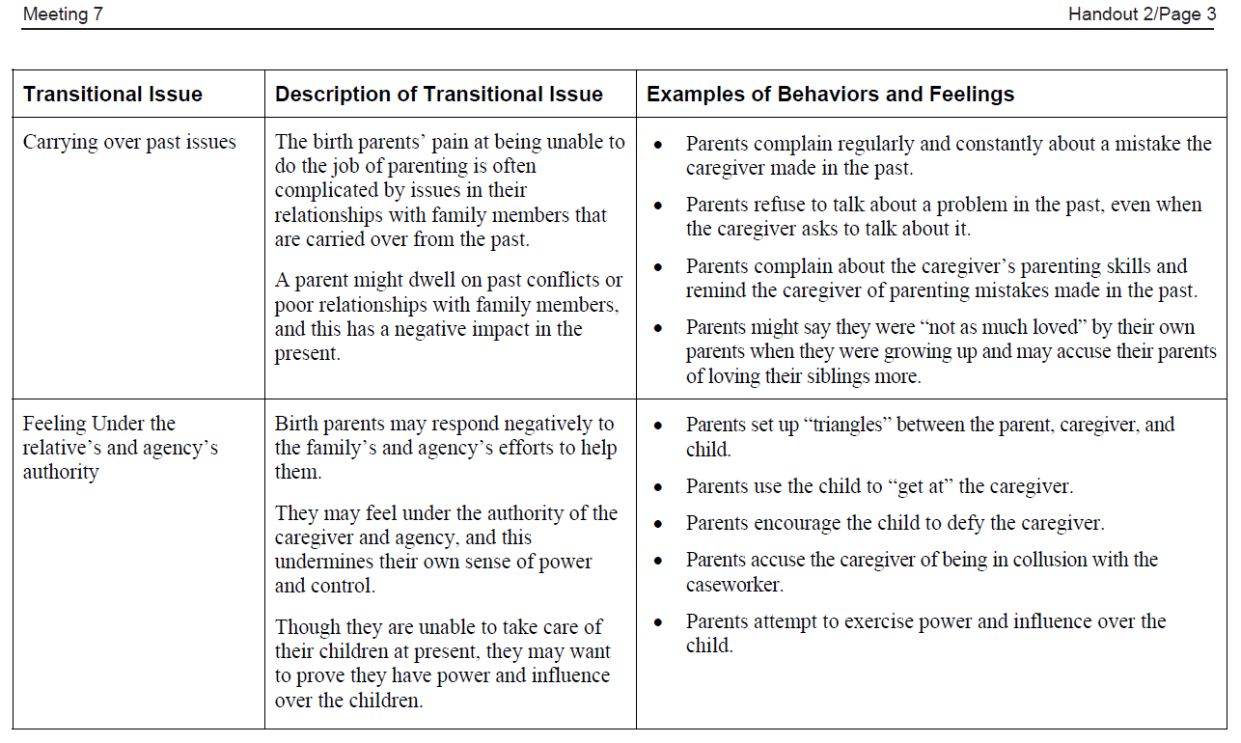
Handout 2, p.3

Slide 102
Handout 2, p.4

Slide 103
Handout 2, p.5

Slide 104
Handout 3, p.1

Slide 105
Handout 3, p.2

Slide 106
Handout 3, p.3

Slide 107
Handout 4

Slide 108
Chemical Dependence
A primary, chronic disease with genetic, psychosocial, and environmental factors influencing its development and manifestations. The disease is often progressive and fatal.
It is characterized by continuous or periodic impaired control over drinking, preoccupation with the drug, and use of the drug despite adverse consequences and distortions in thinking, most notably denial.

Slide 109
Chemically Dependent
A chemically dependent person is someone who continues to use alcohol or other drugs despite repeated negative consequences for one person.

Slide 110
Roles in Families Affected by Chemical Dependence
Father with Chemical Dependence
Enabler (spouse/partner)
Hero
Scapegoat
Lost Child
Mascot

Slide 111
Parent with CD

Slide 112
Parent with CD
“11 feet tall, invincible, and bullet-proof”
Len McDonald, Recovery Partnership

Slide 113
Parent with CD

Slide 114
Parent with CD

Slide 115
Parent with CD
Enabler/Spouse

Slide 116
Parent with CD
Enabler/Spouse

Slide 117
Parent with CD
Enabler/Spouse

Slide 118
Hero

Slide 119
Parent with CD
Enabler/Spouse
Hero

Slide 120
Scapegoat

Slide 121
Parent with CD
Enabler/Spouse
Scapegoat
Hero

Slide 122
Lost Child

Slide 123
Parent with CD
Lost Child
Enabler/Spouse
Scapegoat
Hero

Slide 124
Mascot

Slide 125
Parent with CD
Lost Child
Mascot
Enabler/Spouse
Scapegoat
Hero

Slide 126
Scapegoat

Slide 128
Recovery
An ongoing process of growth and change in all areas of a person’s life especially in the spiritual area.

Slide 129
Handout 5

Slide 130
Relapse
A characteristic of the disease of chemical dependence in which a person returns to using alcohol or other drugs after a period of sobriety.
Common terms used to describe relapse are “lapse back,” “backslide,” and “slip.”
Relapse is more than an isolated event or an instance of taking a drink or using one’s drug of choice; it is a process that begins long before the person actually resumes using the drug.

Slide 131
Handout 6

Slide 132
Handout 7

Slide 133
Handout 8

Slide 134
♦Hopes and Dreams
♦ Grief & Remorse
♦ Accepting a New Relationship
♦ Guilt
♦ Carrying Over Past Issues
♦ Feeling Under the Caregiver’s & Agency’s Authority
♦ Anger & Disappointment
♦ Feeling Betrayed
♦ Planning for Illness or Death

Slide 135
Suggestion
Use Handout 3 “Transitional Issues and Management Strategies for Birth Parents”

Slide 138
Meeting 8
Working with Birth Parents to Achieve Permanency for Their Children
© 2014 New York State Office of Children and Family Services.

Slide 139
Review to Renew
S ________________________________________
A ________________________________________
F ________________________________________
E ________________________________________
T ________________________________________
Y ________________________________________

Slide 140
System
A regularly interacting or interdependent group of items forming a unified whole.
(Webster’s Eleventh New Collegiate Dictionary)

Slide 141
Handout 2, p.1

Slide 142
Handout 2, p.2

Slide 143
Conflict
An incompatible difference in needs, values or goals between two or more people.

Slide 144
Conflict Resolution
A process in which two people agree to work on the problem together and are able to arrive at a solution that meets everyone’s interests and needs as much as possible.

Slide 145
Handout 3

Slide 146
Handout 4

Slide 147
Problems or Challenges with Visits

Slide 148
Benefits of Visits for Children | Benefits of Visits for Parents | Benefits of Visits for Kinship Caregivers

Slide 149
Handout 5

Slide 150
Meeting 9
Networking and Moving Ahead
© 2014 New York State Office of Children and Family Services.

Slide 151
Review to Renew
L ________________________________________
O ________________________________________
V ________________________________________
E ________________________________________

Slide 152
Strengths
Skills, resources, qualities and experiences that are part of each person.
Needs
Underlying conditions that must be met before a person can achieve a goal.

Slide 153
Handout 2

